Slide 1
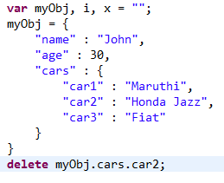
Nested JSON Objects - Delete Object Properties
Use the delete keyword to delete properties from a JSON object

